Slide 1
A Rigorous Experiment about Sentiment Analysis on Comprehensive Bangla text Language Using Machine Learning Techniques
1.Md. Amanullha (Id: 173014040)
2.Md. Rahimuzzaman Bhuiyan
(Id: 173014041)
3.Sumit Chakraborty (Id: 173014014)
Dr. Muhammad Abul Hasan
Assistant Professor,
Dept. of CSE, ULAB
Thursday 11th November 2021

Slide 2
Motivation
NLP is a field under Deep Learning that allow computational linguistics.
It helps to develop system that interacts between machines and natural language that have been evolved for use by humans.

Slide 3
Objective
To determine whether the data is positive, negative or neutral
To help the online business, monitor brand and product sentiment in customer feedback and understand customer needs.

Slide 4
Methodology
Sample(Data sampling and partitioning)
Explore(visualization and relationships)
Modify(data preparation and feature selection)
Model(create model for desired outcome)
Assess(evaluate the modeling result)

Slide 5
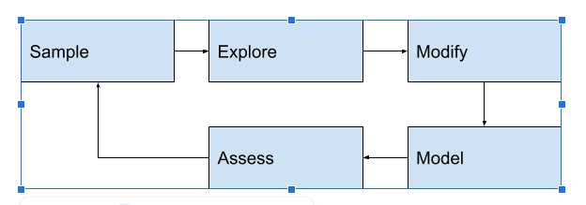
Methodology

Slide 6
Expected Outcome
Understand customer emotions for marketing purposes.
Overview of public opinion.
It helps businesses gain insights and respond effectively to their customers
Understanding the psychology of consumers
Useful in social media to monitor public debates and discussions.
Evaluate reviews on app stores

Slide 7
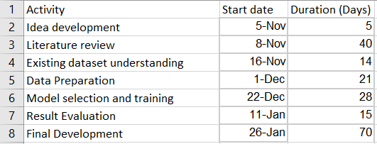
Activity list and duration

Slide 8
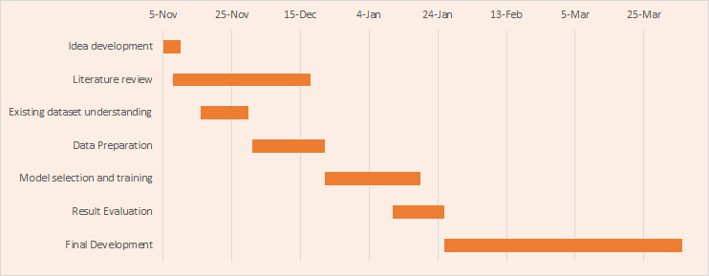
Gantt Chart

Slide 9
Resources
Data set
https://www.kaggle.com/cryptexcode/sentnob-sentiment-analysis-in-noisy-bangla-texts

Slide 10
References
A Survey on Sentiment Analysis
http://surl.li/aqnxg
SentNoB: A Dataset for Analysing Sentiment on Noisy Bangla Texts
http://surl.li/aqnxq
Datasets for Aspect-Based Sentiment Analysis in Bangla
http://surl.li/aqnxv

Slide 11
Thank You

